Slide 1
Generalized graph cuts CS B553 Spring 2013

Slide 2
Announcements
A3 posted
Due Friday March 8, 11:59PM

Slide 3
Faster MAP inference?
We’ve now seen two algorithms for MAP inference:
Variable elimination: Exact, but potentially very slow
Loopy Max-product BP: Fast, but approximate
It turns out that in some cases, MAP problems are easier than Marginal inference problems
One interesting case: With binary random variables, and potential functions that satisfy (relatively weak) restrictions, exact inference on a pairwise Markov network is efficient

Slide 4

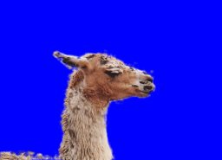
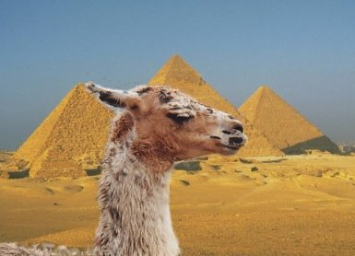
A slightly more interesting problem…
Foreground vs background segmentation
We want to label every pixel of an image with a 0 or a 1, indicating whether it’s a background or foreground pixel
Adapted from N. Snavely’s slide

Slide 5
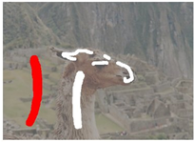
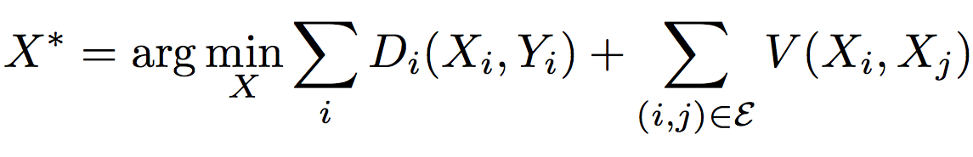
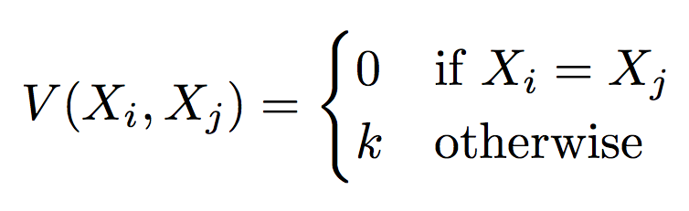
Solving with an MRF
So, we want to solve a problem of the form:
Y variables are given
X variables are binary-valued
D cost functions have any form
V cost functions have the form:
Observed pixel data
Unobservable binary labels

Slide 6
Minimum cut problem
a cut C
Min cut problem:
Find the cheapest way to cut the edges so that the “source” is separated from the “sink”
Cut edges going from source side to sink side
Edge weights now represent cutting “costs”
“source”
“sink”
S
T
A graph with two terminals
Adapted from R. Zabih’s slide

Slide 7
“Augmenting Path” algorithms
Find a path from S to T along non-saturated edges
“source”
“sink”
Increase flow along this path until some edge saturates
S
T
A graph with two terminals
Adapted from R. Zabih’s slide

Slide 8
“Augmenting Path” algorithms
Find a path from S to T along non-saturated edges
“source”
“sink”
Increase flow along this path until some edge saturates
S
T
Find next path…
A graph with two terminals
Increase flow…
Adapted from R. Zabih’s slide

Slide 9
“Augmenting Path” algorithms
Find a path from S to T along non-saturated edges
“source”
“sink”
Increase flow along this path until some edge saturates
S
T
Iterate until all paths from S to T have at least one saturated edge
A graph with two terminals
Adapted from R. Zabih’s slide

Slide 10
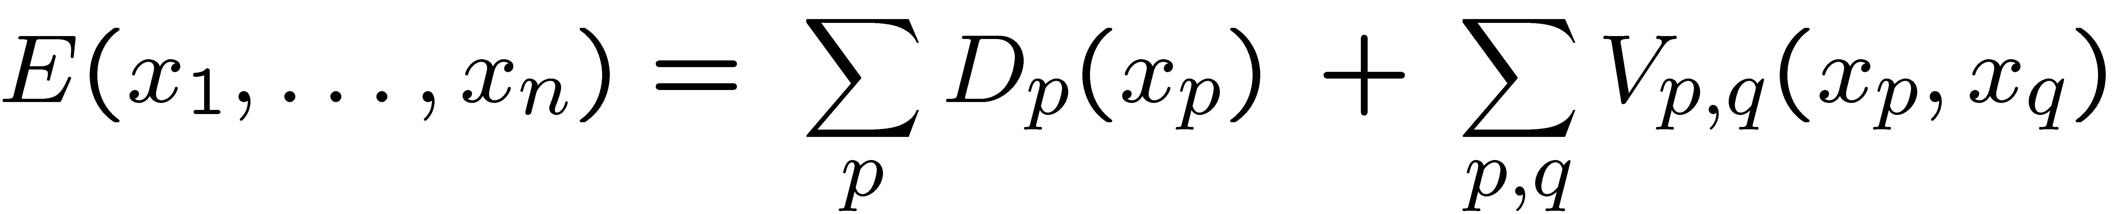
Basic graph cut construction
One non-terminal vertex per pixel
Each pixel has edge to s,t, and neighbors
Edge p-s has weight Dp(0), edge p-t has weight Dp(1)
Edge (p,q) has weight V_{pq}(0,1)
Run graph cuts to find a min cut
Label pixel p 1 if connected to t, and 0 if connected to s
Cost of cut is the cost of the entire MRF labeling
So min cut means we’ve found min-cost labeling!
D_{p}(0)
s
a cut
t
D_{p}(1)
Adapted from R. Zabih’s slide

Slide 11
Example
Pairwise (V) costs:
k₁₂=6, k₂₃=6, k₃₄=2, k₁₄=1
Unary (D) costs:
D1(0)=7, D1(1)=0, D2(0)=0, D2(1)=2, D3(0)=0, D3(1)=1, D4(0)=2, D4(1)=6
asdf

Slide 12
Example
s
7
Pairwise (V) costs:
k₁₂=6, k₂₃=6, k₃₄=2, k₁₄=1
Unary (D) costs:
D1(0)=7, D1(1)=0, D2(0)=0, D2(1)=2, D3(0)=0, D3(1)=1, D4(0)=2, D4(1)=6
asdf
2
1
1
6
0
1
2
6
1
6
2
1
t

Slide 13
Example
s
7
Pairwise (V) costs:
k₁₂=6, k₂₃=6, k₃₄=2, k₁₄=1
Unary (D) costs:
D1(0)=7, D1(1)=0, D2(0)=0, D2(1)=2, D3(0)=0, D3(1)=1, D4(0)=2, D4(1)=6
So MAP labeling is:
X1=X2=X3=1, X4=0
2
1
1
6
0
1
2
6
1
6
2
1
t

Slide 14
Min flow algorithms
Ford-Fulkerson (1962) is the classic algorithm
Takes time O(|E| f), where f is the maximum flow
May not converge in some cases
Edmonds-Karp (1972) gave an improved version
Same as F-F, but the augmented path is always the shortest with available capacity. Can be found using breadth-first search.
Takes time O( |V| |E|² )
Adapted from R. Zabih’s slide

Slide 15
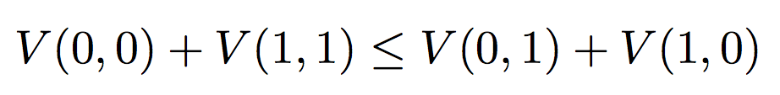
Important properties
Very efficient in practice
Lots of short paths, so roughly linear
Edmonds-Karp max flow algorithm finds augmenting paths in breadth-first order
Specific to binary labels
Can be generalized to handle V cost functions that are submodular, i.e. that obey:
Adapted from R. Zabih’s slide

Slide 16
Can this be generalized for multi-label problems?
Not easily.
NP-hard for even the Potts model [K/BVZ 01]
Two main approaches
1. Exact solution [Ishikawa 03]
Large graph, convex V (arbitrary D)
2. Approximate solutions [BVZ 01]
Solve a binary labeling problem, repeatedly
Expansion move algorithm

Slide 17
Exact construction for L1 distance
E.g. Graph for 2 pixels, 7 labels:
6 non-terminal vertices per pixel
(6 = 7 – 1)
Certain edges (vertical green in the figure) correspond to different labels for a pixel
If we cut these edges, the right number of horizontal edges will also be cut
Can be generalized for convex V (arbitrary D)
D_{p}(0)
D_{q}(0)
p1
q1
D_{p}(1)
p2
q2
p6
q6
D_{p}(6)
D_{q}(6)
Adapted from R. Zabih’s slide

Slide 18
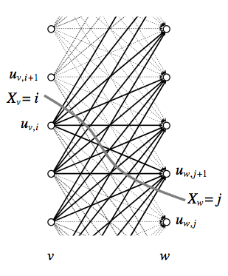
Generalization
Ishikawa (2003) showed how to handle any convex function V
Add diagonal n-links between pixel nodes, with the right choice of edge weights
Labels must be ordered natural numbers (0,1,2,…,L)

Slide 19
Exact inference on multi-label MRFs with graph cuts
Exact inference on MRFs with convex priors is possible in polynomial time, but not practical
E.g. for L1 (linear) distance functions, graph has O(NL) nodes, O(NL) edges, so min-cut running time is O(N³L³)
For L2 (quadratic) distance functions, graph has O(NL) nodes and O(NL²) edges, so min-cut takes time O(N³L⁵)

Slide 20

Convex over-smoothing
Convex priors are widely viewed in vision as inappropriate (“non-robust”)
These priors prefer globally smooth images, which is almost never suitable
This is not just a theoretical argument
It’s observed in practice, even at global min
Adapted from R. Zabih’s slide

Slide 21
Handling robust priors
How do we handle the problem we really want to solve?
Multiple labels
Robust distance functions (discontinuity-preserving)
Willing to solve approximately
Can we generalize the binary case?
Focus first on Potts model
Adapted from R. Zabih’s slide

Slide 22
Can this be generalized for multi-label problems?
Not easily.
NP-hard for even the Potts model [K/BVZ 01]
Two main approaches
1. Exact solution [Ishikawa 03]
Large graph, convex V (arbitrary D)
2. Approximate solutions [BVZ 01]
Solve a binary labeling problem, repeatedly
Expansion move algorithm

Slide 23
Expansion move algorithm
Input labeling f
_{Green expansion move from f}
Make green expansion move that most decreases cost
Then make the best blue expansion move, etc
Done when no α-expansion move decreases the energy, for any label α
See [BVZ 01] for details
Adapted from R. Zabih’s slide

Slide 24

Binary sub-problem
Input labeling
Expansion move
Binary image
Adapted from R. Zabih’s slide

Slide 25
The swap move algorithm
1. Start with an arbitrary labeling
2. Cycle through every label pair (A,B) in some order
2.1 Find the lowest E labeling within a single AB-swap
2.2 Go there if it’s lower E than the current labeling
3. If E did not decrease in the cycle, we’re done
Otherwise, go to step 2
Adapted from R. Zabih’s slide

Slide 26
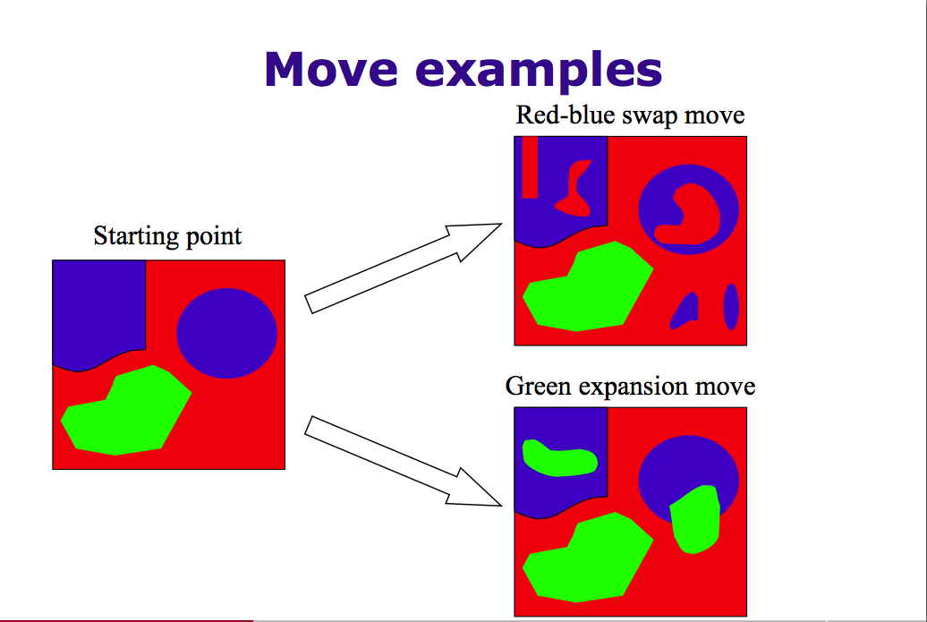
Adapted from R. Zabih’s slide

Slide 27
Another approach
Expansion move algorithm
Cycle through each label
For each label L, solve a binary subproblem in which each pixel either keeps its current label or switches to L
Make the move if cost decreases
Continue until convergence

Slide 28
Adapted from R. Zabih’s slide

Slide 29
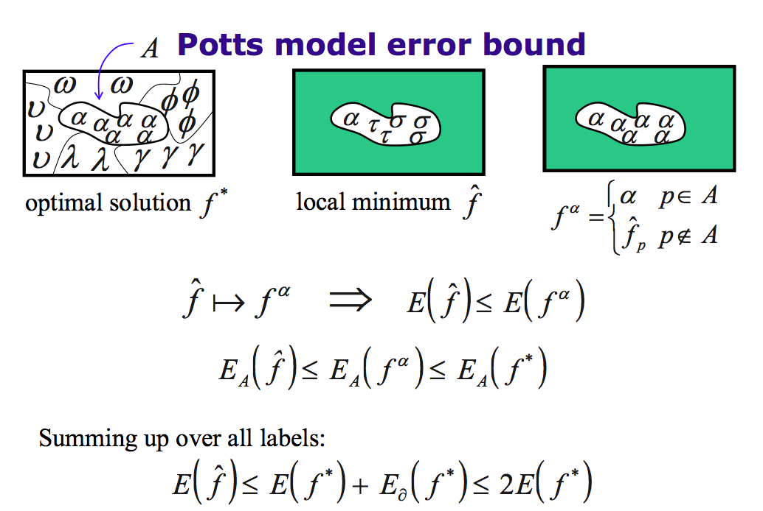
Adapted from R. Zabih’s slide

Slide 30
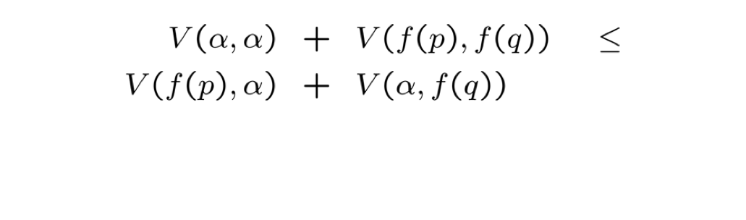
Multi-label graph cuts
The approximate algorithm works for:
D of any form
V must satisfy a (generalized) submodularity constraint:
Adapted from R. Zabih’s slide

Slide 31
Graph cuts properties
Binary graph cuts is key step of inner loop
In each iteration of graph cuts, the total cost can’t increase
Converges to a solution in O(n) steps
In practice, typically converges in just a few steps
At convergence, the solution is a local minimum

Slide 32
Why does graph cuts work so well?
It’s an iterative, hill-climbing approach, but one in which every step is searching over a huge space
Every step searches over O(2^{n}) labelings!
Starting from an arbitrary labeling, you can get to the optimal labeling in just k of these steps
Compare this to other, more obvious hill-climbing techniques, e.g. change a single pixel at a time
Every step searches over just O(1) labelings
Generally yields a weak local minimum

Slide 33
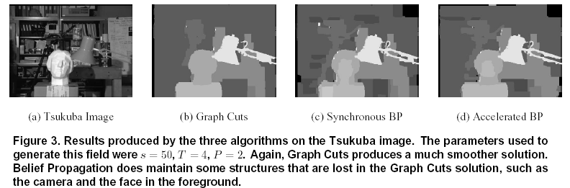
Graph cuts vs BP
Tappen 2003
Adapted from R. Zabih’s slide

Slide 34
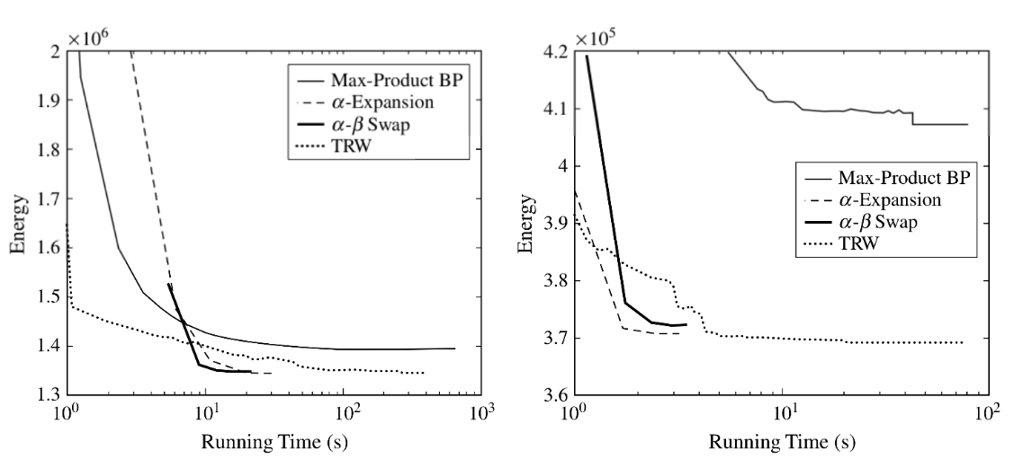
Comparing techniques on stereo
Compare techniques on cost of best solution (“energy”) versus time

Slide 35
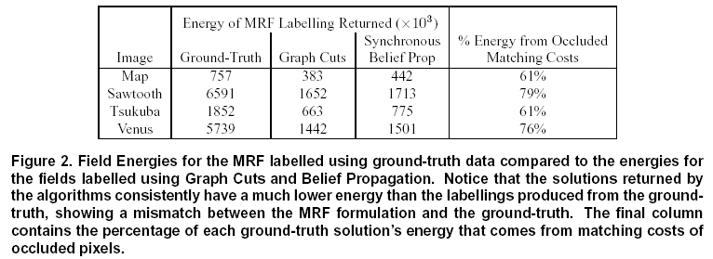
Ground truth vs Graph cuts vs BP
Adapted from R. Zabih’s slide

Slide 36
Graph cuts vs BP
Graph cuts typically finds slightly lower-energy solutions
However, lower-energy is not necessarily better…
BP is typically faster
More theoretical results are known for graph cuts
On 2 label problems, graph cuts gives exact solution
On multilabel problems with convex cost functions, GC gives solutions in polynomial time (but not practical in practice)
BP is more general
Works on any graph structure, and any pairwise cost function
Can choose MAP inference or compute marginals
Easier to implement
Adapted from R. Zabih’s slide

